Slide 1
SharePoint services
Provides team collaboration through SharePoint Sites and makes it easy for communities to work together on documents, tasks, contacts, events, and other information.
SharePoint sites are made up of Web Parts and Windows ASP.NET based components.
Windows SharePoint Services provides Web sites for team collaboration
SharePoint Services can scale to thousand of sites within the organization

Slide 2
Web Parts
Web Parts are designed to be add-ons to web pages and configured by site administrators and users to create complete page-based applications
They are all additional components that can be created using visual studio and they can be saved as dwp files. Dash board Web Part(DWP) files are web part files used to describe document files including share point files.
Search, Browse, Upload are few of the available web parts
They can be added by administrator, using Site Settings -> Add Web Parts link

Slide 3
SharePoint Sites
SharePoint sites are places where teams can participate in discussions, shared document collaboration , and surveys.
Sites content can be accessed from a Web Browser.
Managers can customize the layout of the sites so that site members can access and work with relevant information.

Slide 4
SharePoint Server
SharePoint server belongs to Microsoft family of servers
Integrated suite of server capabilities
Hosted Application – i.e. runs on a windows server O/S
Support for Intranet, extranet access available
Improves organizational effectiveness by sharing information, content management

Slide 5
SharePoint Features
Document Management
Can create, upload, modify, check in and check out, delete documents
Centrally store documents and access them from anywhere.
User Management
Create users, groups, change password
Content Management
Can create sites and sub sites for every entity like testing team, development team, guests etc and provide contents appropriate for them

Slide 6
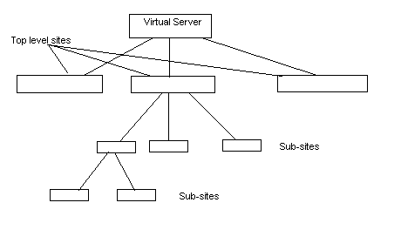
Architecture
Notes:
There will be a single virtual server. It is extended across different ports. In each port we can create a top level site. Every top level site can contain several sub sites which can extend to many levels.

Slide 7
Beneficiaries of SharePoint
Business Manager
Can access contents (files) that are confidential from remote place if provided with proper credentials
Minimizes operation cycle time and travel time
IT Professional
High availability, security of artifacts
Simplicity in accessing contents
End user
Alerts through email
Dash boards to compare results
Message boards to discuss matters

